Slide 1

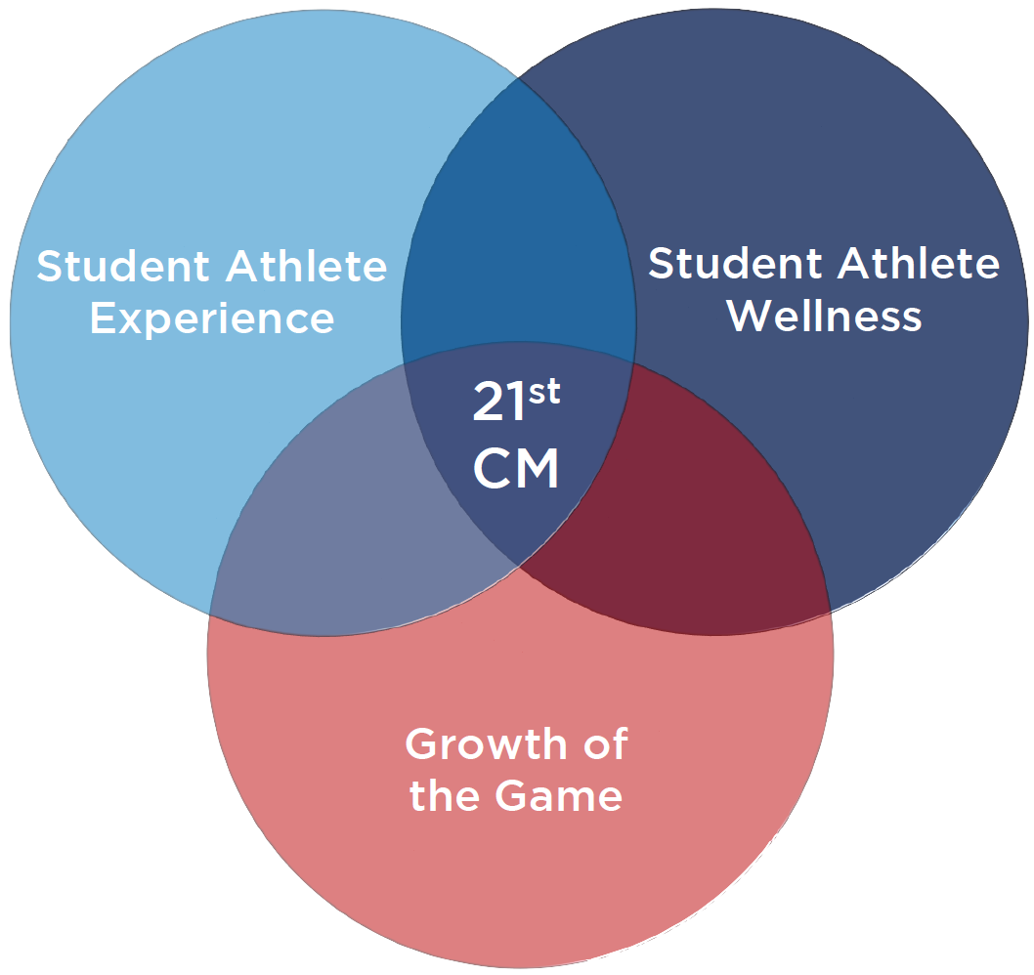





Division I Men’s Soccer
21st Century Model
“FOR THE PLAYERS, FOR THE GAME”
Pursuit of Change in Playing Season Structure

Slide 2
www.21stcenturymodel.org
All information presented can be found on the 21st century model website

Slide 3
STATE OF DIVISION I SOCCER

Slide 4
CURRENT CALENDAR
Current Division I Men’s Soccer playing season – 132 Overall Days
Fall/Championship Segment
13+ weeks with 1st regular season game 12 weekends prior to the start of the NCAA Championship (August 24th in 2018)
20 games including up to 3 exhibition games
Typically 17-18 games over 10-11 weeks plus a conference tournament
Required one day off per week
20 hours maximum of CARA per week
Spring/Non-Championship Segment
8+ weeks typically starting in mid-February and ending in late April
8+ weeks in which to use 5 dates of competition
Required one day off per week
20 hours maximum of CARA per week

Slide 5
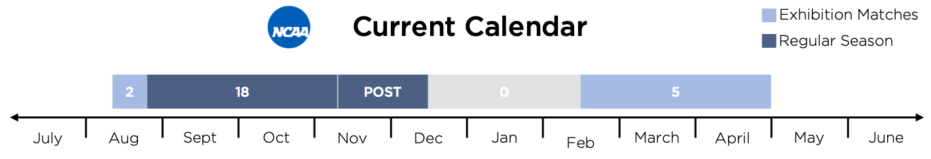
CURRENT CALENDAR
THE PROBLEM…
Playing season compression leading to academic stress, overuse and injury, and lack of quality opportunities for training and instruction.

Slide 6
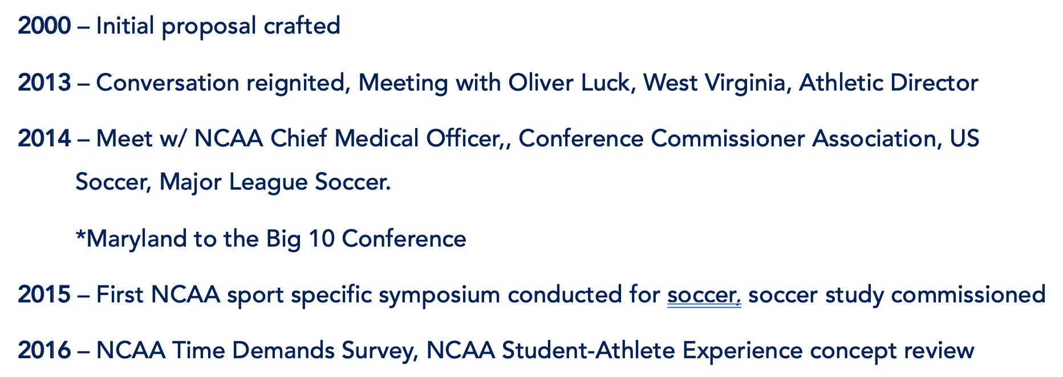
21ST CENTURY MODEL DEVELOPMENT HISTORY

Slide 7
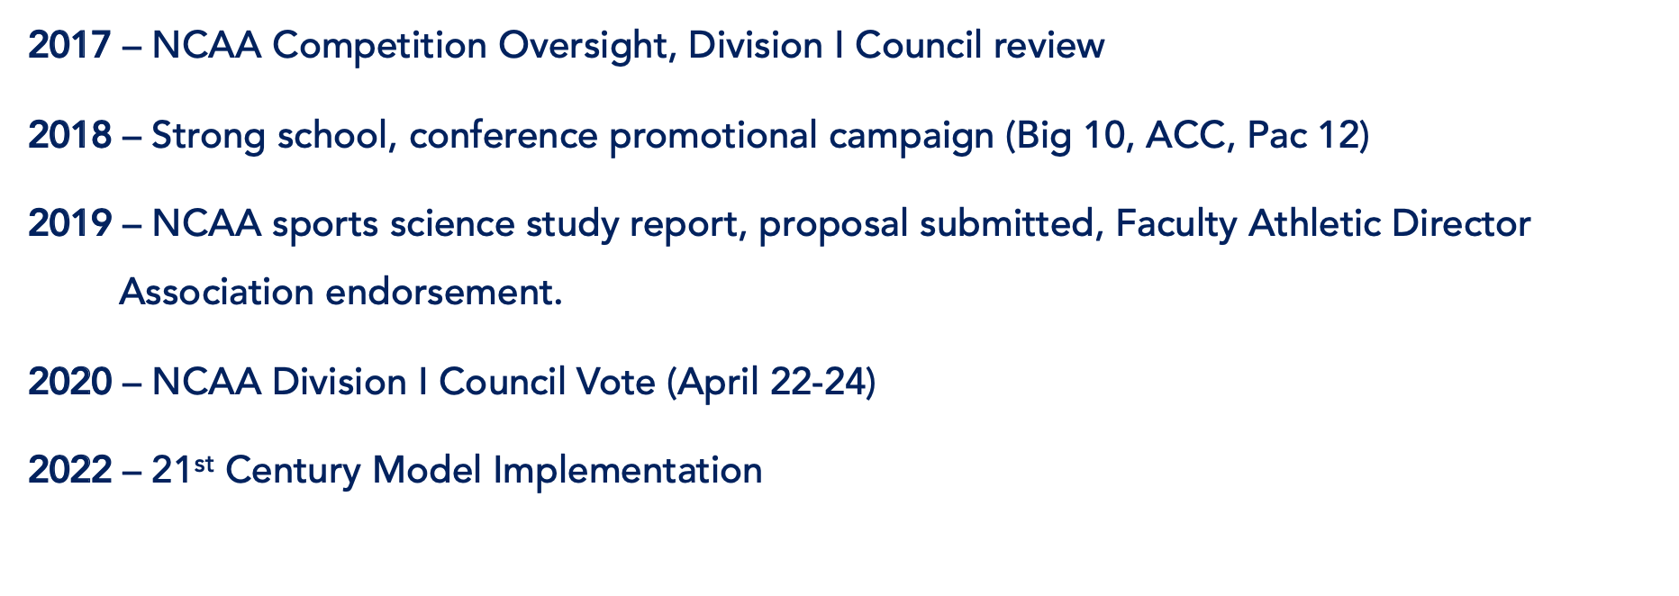
21ST CENTURY MODEL DEVELOPMENT HISTORY

Slide 8
21ST CENTURY MODEL CALENDAR
WHAT IS BEING PROPOSED?
To implement a two-semester playing season model in the sport of Men’s Soccer designed to more evenly distribute academics, competition and student life by:
Redistribution of Current 132 Day Season
Reducing Missed Classes
Reduction and Redistribution of Competitions
Providing Holidays and Summers Off

Slide 9
21ST CENTURY MODEL CALENDAR
Decrease the Total Number of Competitions:
From 25 Total Matches to 23 Total Matches
Redistribute Competitions:
6 Fewer Matches in the Fall
4 Additional Matches in the Spring.
Post Season Moved from Winter to Spring.
Average 1.5 Midweek Games PER semester
Currently SIX to EIGHT in one semester.
HOW?

Slide 10
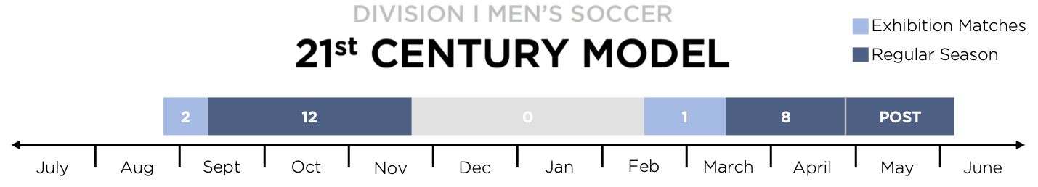
21ST CENTURY MODEL CALENDAR

Slide 11
HEALTH AND WELLNESS IMPACT
Injury Prevention
Balanced Schedule
Prevents Match Congestion and Load Spiking
Consistent Balance of Academics, Athletics, and Student Life
Re-Injury Prevention
Reduced Psychological Pressure
Discourages Rushed Return From Injury Due to Compact Season
Allows Time to Recover from Injury and Time to Acclimate to College

Slide 12
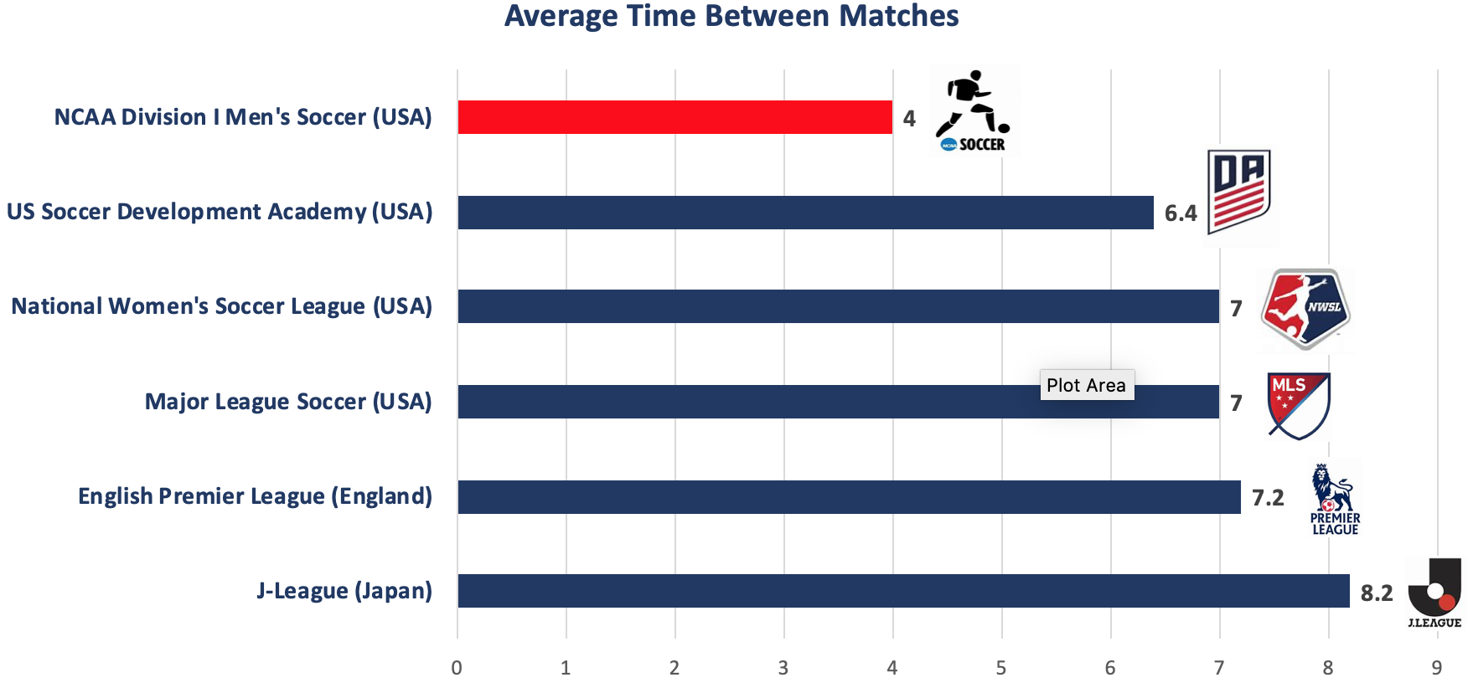
HEALTH AND WELLNESS IMPACT

Slide 13
HEALTH AND WELLNESS IMPACT
“The injury rate was significantly higher when players played 2 matches per week versus 1 match per week. (25.6 vs 4.1 injuries per 1000 hrs of exposure)” - Dupont, G., Nedelec, M., McCall, A., McCormack, D., Berthoin, S., Wisloff, U. Effect of 2 soccer matches in a week on physical performance and injury rate. (2010) American Journal of Sports Medicine, 38 (9), pp. 1752-1758.

Slide 14
NCAA Report: Prevention of Catastrophic Injury & Death in the Intercollegiate Athletes
“It takes approximately seven to 10 days for the body to acclimatize to the physiologic and environmental stresses placed upon it at the start of a conditioning or practice period, especially during periods of warm or hot weather.”

Slide 15
NCAA Sports Science Report Summary: Study Conducted by the Korey Stringer Institute (University of Connecticut)
“…preseason injuries occurring in practices were substantially higher than at any other point in the season or postseason…”
“…higher rates of injuries when matches occurred with 5 or less days of rest between games…”

Slide 16
ACADEMIC IMPACT
Reduced Missed Class Time
Graduation and Retention
Decrease of midweek games from between 6 - 8 in one semester to 3 over two semesters.
Discourages Mid-Year and Early Departure for MLS Draft
Supports Transition to College
High-Impact Educational Experiences
Uninterrupted First Year Orientation
Extensive 1st Semester Final Exam Preparation Period
Summer Study Abroad and Internships

Slide 17
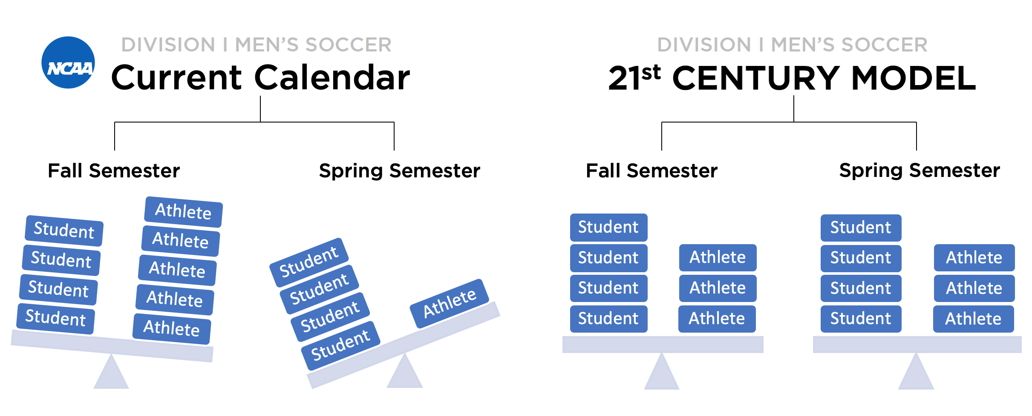
STUDENT-ATHLETE EXPERIENCE IMPACT

Slide 18
ALIGNMENT WITH GROWTH OF THE SPORT
Time to Train and Develop
Enhanced Fan Experience
One Game per Seven Days Aligns with All Other Competitive Leagues
Weekend Matches and Improved Quality of Play
Improved Quality of Training and Games
Proper Balance of Games
Proper Ratios Allow Improved Performance Resulting in a More Positive Athletic Experience
Currently Too Many in the Fall, Too Few in the Spring
COLLEGE SOCCER COULD BE THE BEST U23 LEAGUE IN THE WORLD
Already appealing to top youth players internationally
As of the 2018 Season 34% of Division I men’s soccer players are internationals
This is a 62% increase since 2013

Slide 19
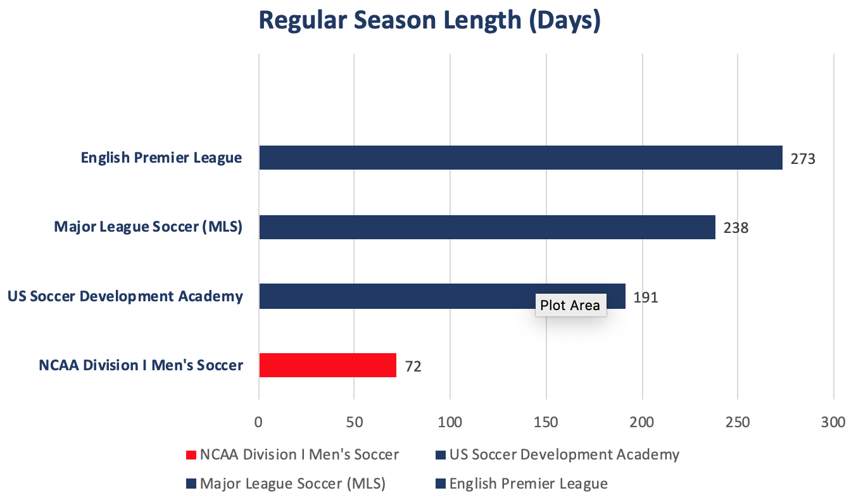
ALIGNMENT WITH GROWTH OF THE SPORT
COLLEGE SOCCER COULD BE THE BEST U23 LEAGUE IN THE WORLD
Already appealing to top youth players internationally
As of the 2018 Season 34% of Division I men’s soccer players are internationals
This is a 62% increase since 2013

Slide 20
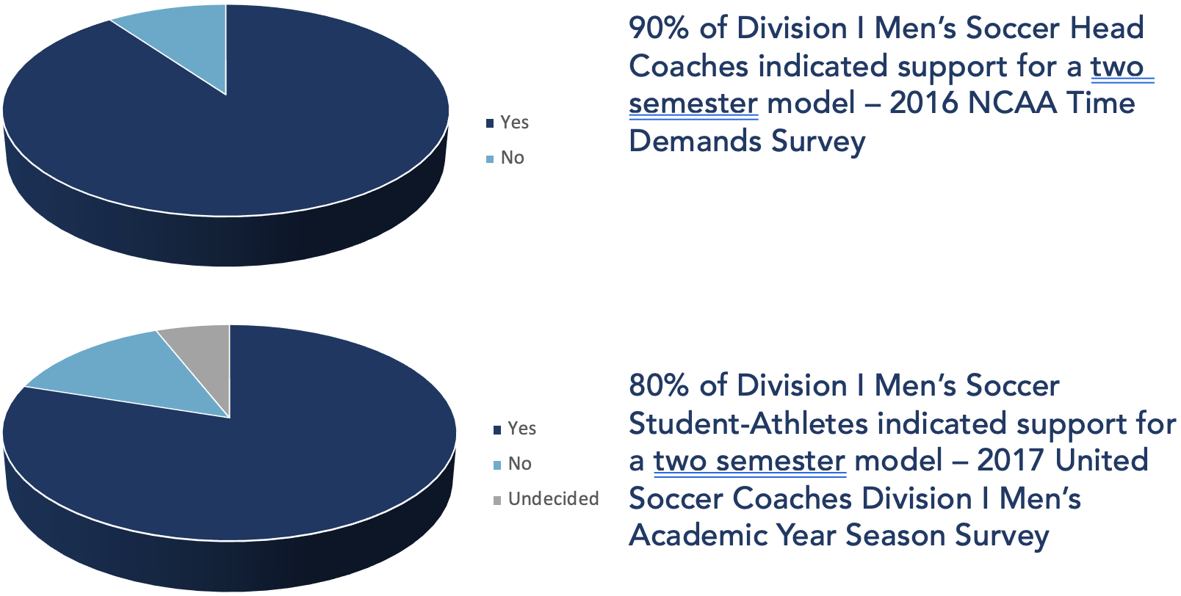
SUPPORT OF THE 21st CENTURY MODEL
2017 NCAA Time Demands Survey
70% of Student Athletes Expressed Support for a Two Semester Championship

Slide 21
GENERAL CONCERNS
IS IT BAD FOR ACADEMIC WELL-BEING?
Negative impact of postseason play occurring during the Spring final examination period.
RESPONSE: Postseason play in the current model occurs during the Fall term final examination period.
Spring semester provides an opportunity to take a heavier course load.
RESPONSE: Data collected from 8 of 12 ACC institutions suggests that there is not significant difference between Fall and Spring credit hours attempted - 13.8 (Fall) to 14.1 (Spring).
COULD IT HURT TEAM ACADEMIC PROGRESS RATE (APR)? WHAT ABOUT THE DRAFT?
Decreased APR due to student-athletes declaring for the MLS Draft in January.
RESPONSE: This legislation is designed for the 4000+ Student Athletes that DI College soccer, not the 40 who move on to the MLS
Will diminish number of terms available to rectify eligibility issues.
RESPONSE: Should legislation be crafted to benefit the health, well-being and academic success of all student-athletes in mind OR for the few who cannot meet minimum academic standards?

Slide 22
GENERAL CONCERNS
IS IT BAD FOR ATHLETIC WELL-BEING?
Will result in a loss of a “developmental” season.
RESPONSE: Presently, there are very few quality training opportunities due to the need for constant recovery. This prohibits all student-athletes from quality training in the Fall.
Pressure of being “in-season” during both semesters could be a distraction.
RESPONSE: Is it a distraction for Basketball, Tennis, Golf, Ice Hockey, Wrestling, Swimming & Diving, Track & Field who currently have operate in a two-semester model?
Diminish time for student-athletes to have surgery outside of the competition schedule.
RESPONSE: Allows student-athletes to miss less games due to minor injuries and provides proper recovery, Well balanced schedule will reduce injuries.

Slide 23
GENERAL CONCERNS
Programs will look to secure facilities during the same practice and game times.
RESPONSE: Soccer currently uses facilities and staff during the Spring semester. Total number of days in the playing season remains unchanged. ACC data suggests as few as six (6) additional days.
WILL IT INCREASE FACILITY CONFLICTS WITH SPRING SPORTS?
WHAT IF WOMEN’S SOCCER ALSO WANTS TO CHANGE THEIR PLAYING SEASON?
Could increase conflicts with facilities and staff, result in an unbalanced number of championships.
RESPONSE: Only 50% of Women’s Soccer coaches and 17% of Women’s Soccer student-athletes have expressed support for a two-semester model.

Slide 24

Co-Sponsoring legislation
WITH SUPPORT OF
COMMITTEE ON COMPETITIVE SAFEGUARDS AND MEDICAL ASPECTS OF SPORTS
Statement on Soccer Study

Slide 25



For more information
RETWEET AND LIKE
                @21stCMSoccer
                @21stCMSoccer
                @21stCenturyModel.info
USE HASHTAG: #21stCenturyModel
VISIT www.21stcenturymodel.org

Slide 26
Division I Men’s Soccer
21st Century Model
“FOR THE PLAYERS, FOR THE GAME”

