Slide 1
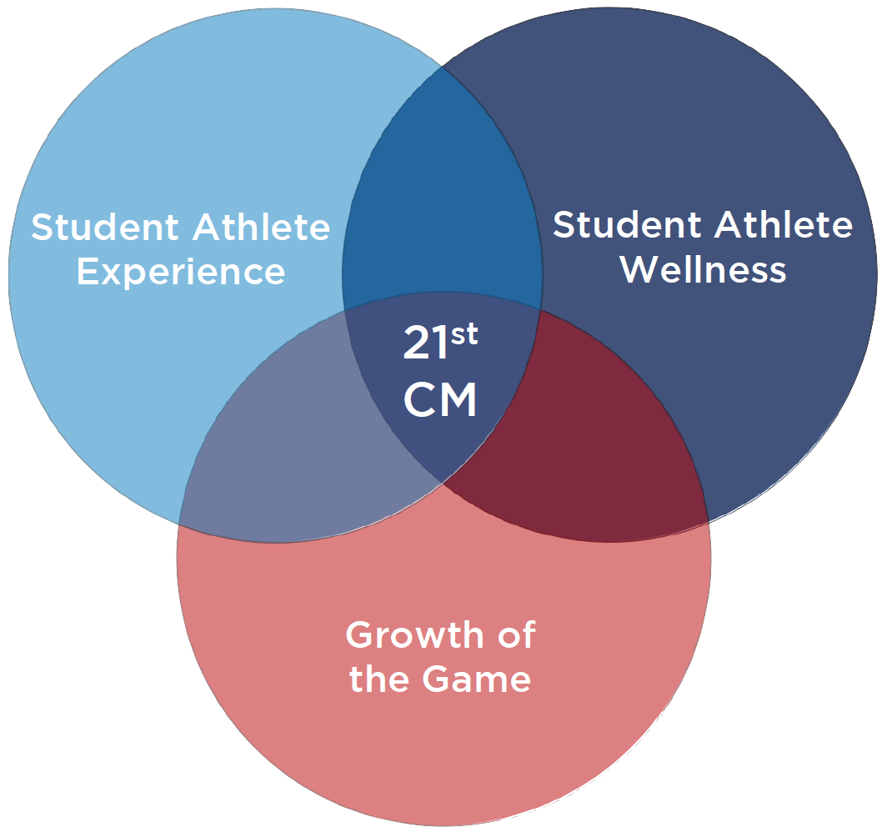
Division I Men’s Soccer
21st Century Model
“FOR THE PLAYERS, FOR THE GAME”

Slide 2
REDISTRIBUTION OF COMPETITIONS OVER TWO SEMESTERS:
6 Fewer Matches in the Fall, 4 Additional Matches in the Spring. Post Season Moved from November/December to May/June.
REDUCED MIDWEEK GAMES:
Maximum 3 midweek games through the academic year vs 6-8 midweek games in ONE semester.
ATHLETIC BREAKS
Fall competition starts 2nd week in September and ends prior to Thanksgiving / holiday plans can be made without competition conflicts
November–January (significant time for final exam preparation and J-term classes)
Summer – May/June to late August (summer school, internships, study abroad, work, summer teams)

Slide 3
BENEFITS OF THE 21ST CENTURY MODEL
BALANCED SCHEDULE
Physical, mental, emotional, and academic health benefits through a balanced training, competition, and rest/recovery schedule.
REDUCED MISSED CLASSES
Reduced mid-week games and distribution of missed classes over two semesters.
GRADUATION RETENTION
Students encouraged to use 4 years to complete their degree instead of rushing to complete in 7 semesters.
TRANSITION TO COLLEGE IN CRITICAL 1st YEAR
Un-interrupted first year orientation.
Acclimatization period before 1st match.
Full year to acclimate to college soccer allows younger players more time to adjust and contribute.
Extensive 1st semester final exam preparation period with limited soccer activity.

Slide 4
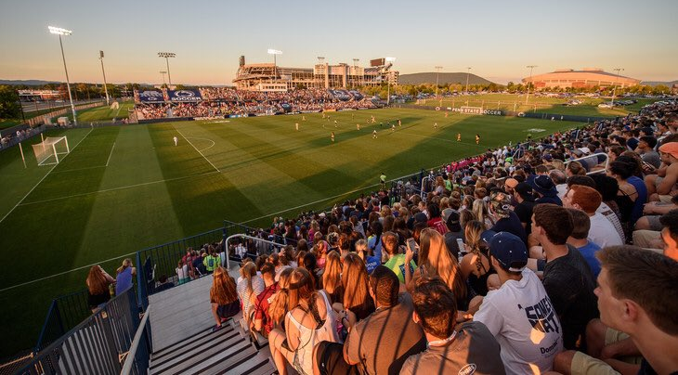
BENEFITS OF THE 21ST CENTURY MODEL
TRUE SUMMER BREAK
Reduced reliance on summer as preparation phase.
Allows opportunity for high-impact educational experiences in summer i.e. internships, study abroad, etc.
ENHANCED ATHLETIC EXPERIENCE
Quality training and quality matches due to decompression of schedule.
Championship Experience: Improved playing conditions at championships.
Balanced Schedule Reduces Fall Pressure Points and Allows for Development Throughout the Year.
Consistent Team in Fall and Spring Promoting Better Team Chemistry and Better Quality Performance.
MORE COMMUNITY ENGAGEMENT AND ENHANCED FAN EXPERIENCE
Weekend matches allow for more community engagement opportunities as well as attendance.
Improved quality of play enhances fan experience.

Slide 5
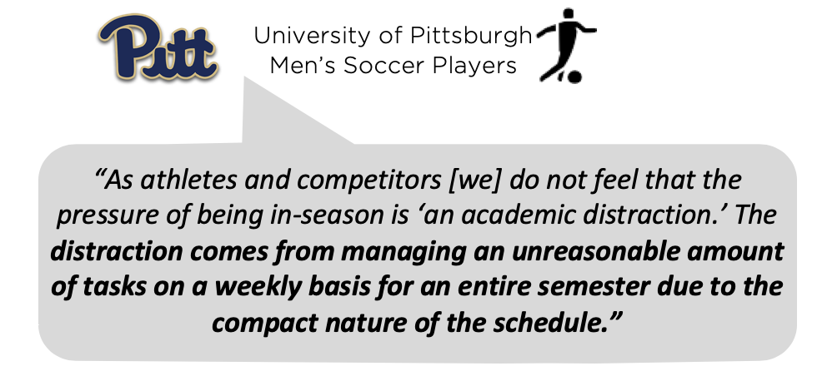
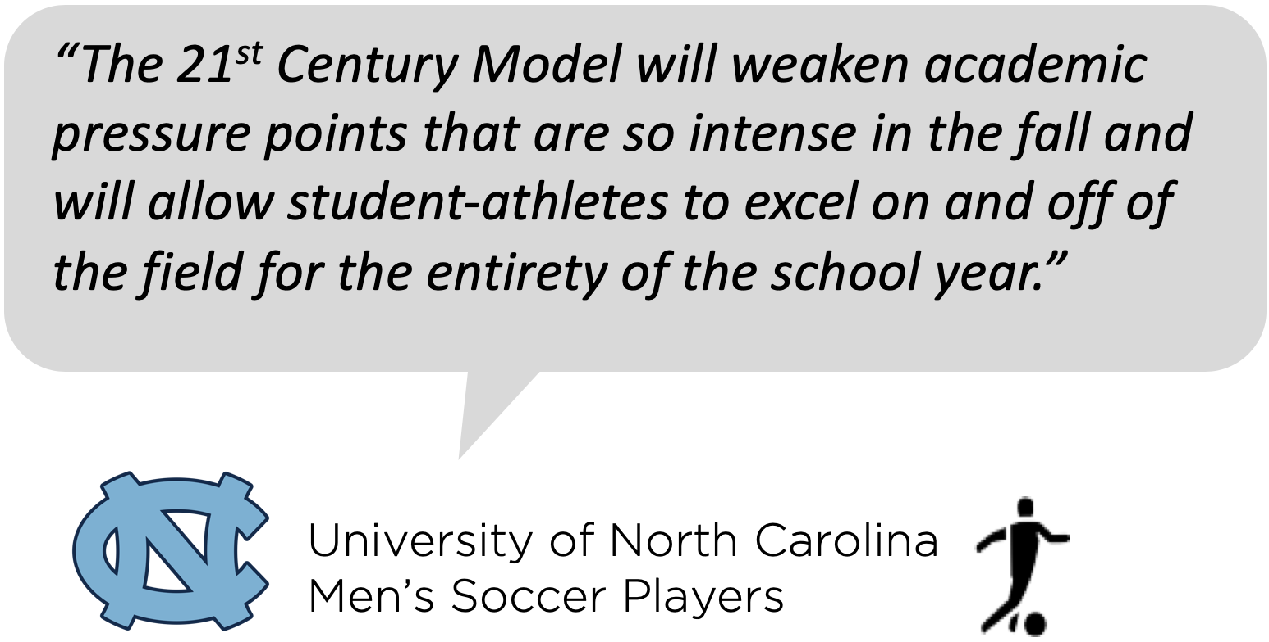
“The 21st Century Model will weaken academic pressure points that are so intense in the fall and will allow student-athletes to excel on and off of the field for the entirety of the school year.”
Support for the 21st century model
University of North Carolina Men’s Soccer Players
Co-Sponsoring legislation
With support of
National support
90% Division I Men’s Soccer Coaches
80% Division I Men’s Soccer Student-Athletes

Slide 6
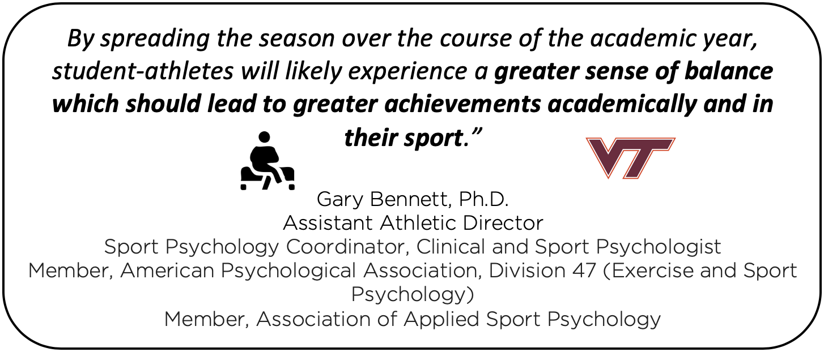
Support for the 21st century model
Sports Science and Doctors
Athletic directors

Slide 7
Take action
VOTE IS IN APRIL – NO TIME TO WASTE
Educate your CAMPUS
Who is your school’s SAAC Rep?
Who can educate the AD, SWA, FAR, Athletic Trainer, Strength Coach
Every vote matters, and every opinion matters.
www.21stcenturymodel.org
Familiarize yourself with the specifics of the model
and learn how to address common concerns
CONFERENCE REPS AND AD’s
TALK TO OTHER ADMINISTRATORS…
WHO TALK SUPPORT STAFF…
WHO TALK TO YOU!
YOU CAN AFFECT CHANGE!!

Slide 8
SOCIAL MEDIA
@21stCMSoccer
@21stCMSoccer
@21stCenturyModel.info
USE HASHTAG: #21stCenturyModel
DOWNLOAD SHAREABLE GRAPHICS
CLICK HERE TO DOWNLOAD SHAREABLE GRAPHICS
Find Graphics here: https://www.21stcenturymodel.org/take-action
SOCIAL MEDIA CAMPAIGN – Date TBD
Social Media Campaign to get the 21st Century Model Trending on Social Media
Tweet provided tweet or Retweet from Twitter Account
Use #21stCenturyModel on any social media platform

Slide 9
DETAILED SCHEDULE FOR REFERENCE
Fall Segment
13+ weeks (incl. preseason) with 1st reg. game Fri. of 12th weekend before NCAA tourney (8/30 in 2019)
20 games, incl. up to 3 exhib, which may occur prior to 8/30
Typically 17-18 games over 10 or 11 weeks (depending on conf. tourney format) plus a conf. tournament
Required 1 day off per week
20 hours max. of CARA per week
NCAA Tournament
Current format: 4 weekends with semis and final on Fri./Sun. of same weekend in mid. Dec.
Winter Break
7-day break following the conclusion of the fall season
No CARA the week prior to finals through inst. vacation period; 8 hrs/wk out-of-season CARA otherwise
Spring/ Non championship Segment
8+ weeks, typically starting in mid-Feb. and ending in late April with spring break excluded/given off
8+ weeks in which to play 5 games (or technically use 5 dates of competition)
Required 1 day off per week
20 hours max. of CARA per week
Note: Per NCAA rules, the "132-day" season excludes from counting the required 1 day off per week as well as any days off provided during institutional vacation periods.
This is why "22 weeks" in the context of NCAA playing and practice season rules equals 132 days (22 x 6) as opposed to 154 days (22 x7).

Slide 10
DETAILED SCHEDULE FOR REFERENCE
Fall Segment
12 weeks/13 weekends (including preseason) ending on the Sunday immediately prior to Thanksgiving
12 weeks/13 weekends in which to play 14 games, including up to 2 exhibitions
No more than 2 midweek games (Mon.-Thu.) allowed
Required 1 day off per week
20 hours max. of CARA per week
Winter Break
7-day break following the fall segment
No CARA the week prior to finals through inst. vacation period; 8 hrs/wk out-of-season CARA otherwise
Spring Segment
10 weeks/11 weekends counting back, beg. with the weekend prior to start of the NCAA tourn.
10 weeks/11 weekends in which to play 9 games incl. up to 1 exhibition plus a conf. tournament
No more than 1 midweek game (Mon. - Thu.), excluding conference tournament
Required 1 day off per week
20 hours max of CARA per week
NCAA Tournament
Using current format, 4 weekends, ending on Mem. Day Weekend; semis/final on 5/22 and 5/24 above
5-weekend alt. format: semis on campus on 4th wknd, final on Sat. or Sun. after Mem. Day, 5/30 or 31 above

Slide 11
CONFERENCE VOTES
Majority within conference earns all conference votes
Autonomous Five
Group of Five
FCS
BKS (non-football)
ACC - 4
BIG10 - 4
PAC12 - 4
BIG12 - 4
SEC - 4
C-USA - 2
AAC - 2
MAC - 2
MWC - 2
SUN BELT - 2
Big Sky - 1
Big South - 1
CAA - 1
Ivy – 1
MEAC - 1
NEC - 1
OVC - 1
Patriot - 1
Southern - 1
Southland - 1
SWAC - 1
AEC - 1
ASUN - 1
A10 - 1
Big East - 1
Big West - 1
Horizon - 1
MAAC - 1
MVC - 1
Summit – 1
WCC - 1
WAC - 1
52
Potential
Votes
CONFERENCE COMMISSIONERS
Majority within conference commissioner groups earn all conference commissioner group votes
8
Potential
Votes
Autonomous
Five - 4
Group of
Five - 2
FCS - 1
BKS – 1
(non-football)
OTHER VOTES
Each Student and FAR Representative Gets 1 Vote
4
Potential
Votes
Student
Athlete
Rep - 1
Student
Athlete
Rep - 1
FAR
Rep - 1
FAR
Rep - 1
NEED 33 OF 64 VOTES TO PASS LEGISLATION
64
Total
Votes

